Slide 1
Chapter 18 Recursion

Slide 2
Motivations
Suppose you want to find all the files under a directory that contains a particular word. How do you solve this problem? There are several ways to solve this problem. An intuitive solution is to use recursion by searching the files in the subdirectories recursively.

Slide 3
Objectives
To describe what a recursive method is and the benefits of using recursion (§18.1).
To develop recursive methods for recursive mathematical functions (§§18.2–18.3).
To explain how recursive method calls are handled in a call stack (§§18.2–18.3).
To solve problems using recursion (§18.4).
To use an overloaded helper method to derive a recursive method (§18.5).
To implement a selection sort using recursion (§18.5.1).
To implement a binary search using recursion (§18.5.2).
To get the directory size using recursion (§18.6).
To solve the Tower of Hanoi problem using recursion (§18.7).
To draw fractals using recursion (§18.8).
To discover the relationship and difference between recursion and iteration (§18.9).
To know tail-recursive methods and why they are desirable (§18.10).

Slide 4
Recursion
Recursion occurs when a method calls itself. (It is a loop created by a method calling itself.)
The point of using recursion is to make shorter, more efficient methods
Anything done with recursion can also be done with loops in a regular method, but it’s often longer and more tedious.
Notes:
If a method contains a call to itself, that method is recursive. Recursion is a very useful programming tool if used properly.

Slide 5
Recursion
A recursive method tries to do as little as possible itself, but instead pass the rest of the work off to another version of itself that it calls.
Notes:
If a method contains a call to itself, that method is recursive. Recursion is a very useful programming tool if used properly.

Slide 6
Recursion
Imagine you had someone standing at the beginning of a long line who wants to know how many people are in it.
He doesn’t want to do all the work of counting himself, so he asks the person behind him how many people are in the line.
That person asks the one behind them, and so on.
When the last person in the line is asked, they say “1”.
The person in front of them adds 1 to it and tells that to the person in front of them.
Thus, the count is passed back up the line with each person adding 1 to the count from the person behind them.
When the person at the front gets the final value given to him, he adds 1 to it and has the number of people in line.
He wanted to do as little work as possible, so he passed most of it off to the people behind him, and they did the same to the people behind them.
Notes:
If a method contains a call to itself, that method is recursive. Recursion is a very useful programming tool if used properly.

Slide 7
Computing Factorial
Imagine you are writing a function to compute the factorial of a number. The factorial of n is:
n * (n-1) * (n-2) … * 1 (factorial(0) = 1)
(The factorial of 5 = 5 * 4 * 3 * 2 * 1 * 1= 120)
n! = n * (n-1)! as long as n > 0
0! = 1
(n! stands for the factorial of n)

Slide 8
Computing Factorial
animation
factorial(0) = 1;
factorial(n) = n*factorial(n-1);
Let’s calculate factorial(4)
factorial (4) = 4 * factorial(3)
factorial (3) = 3 * factorial(2)
factorial(2) = 2 * factorial(1)
factorial (1) = 1 * factorial (0)
factorial (0) = 1

Slide 9
Computing Factorial
animation
factorial(0) = 1;
factorial(n) = n*factorial(n-1);
Let’s calculate factorial(4)
factorial (4) = 4 * factorial(3)
factorial (3) = 3 * factorial(2)
factorial(2) = 2 * factorial (1)
factorial (1) = 1 * 1 = 1
factorial (0) = 1

Slide 10
Computing Factorial
animation
factorial(0) = 1;
factorial(n) = n*factorial(n-1);
Let’s calculate factorial(4)
factorial (4) = 4 * factorial(3)
factorial (3) = 3 * factorial(2)
factorial(2) = 2 * 1 = 2
factorial (1) = 1 * 1 = 1
factorial (0) = 1

Slide 11
Computing Factorial
animation
factorial(0) = 1;
factorial(n) = n*factorial(n-1);
Let’s calculate factorial(4)
factorial (4) = 4 * factorial(3)
factorial (3) = 3 * 2 = 6
factorial(2) = 2 * 1 = 2
factorial (1) = 1 * 1 = 1
factorial (0) = 1

Slide 12
Computing Factorial
animation
factorial(0) = 1;
factorial(n) = n*factorial(n-1);
Let’s calculate factorial(4)
factorial (4) = 4 * 6 = 24
factorial (3) = 3 * 2 = 6
factorial(2) = 2 * 1 = 2
factorial (1) = 1 * 1 = 1
factorial (0) = 1

Slide 13
Computing Factorial
animation
factorial(0) = 1;
factorial(n) = n*factorial(n-1);
What would the function look like?
public static int factorial (int n)
{
if (n == 0)
return 1; // the factorial of 0 = 1
else
return n * factorial (n-1);
}

Slide 14
Trace Recursive factorial
animation
Executes factorial(4)

Slide 15
Trace Recursive factorial
animation
Executes factorial(3)

Slide 16
Trace Recursive factorial
animation
Executes factorial(2)

Slide 17
Trace Recursive factorial
animation
Executes factorial(1)

Slide 18
Trace Recursive factorial
animation
Executes factorial(0)

Slide 19
Trace Recursive factorial
animation
returns 1

Slide 20
Trace Recursive factorial
animation
returns factorial(0)

Slide 21
Trace Recursive factorial
animation
returns factorial(1)

Slide 22
Trace Recursive factorial
animation
returns factorial(2)

Slide 23
Trace Recursive factorial
animation
returns factorial(3)

Slide 24
Trace Recursive factorial
animation
returns factorial(4)

Slide 25
factorial(4) Stack Trace

Slide 26
Problem Solving Using Recursion
In general, to solve a problem using recursion, you break it into subproblems. If a subproblem resembles the original problem, you can apply the same approach to solve the subproblems recursively. A subproblem is almost the same as the original problem in nature with a smaller size.

Slide 27
Characteristics of Recursion
All recursive methods have the following characteristics:
  The method is implemented using a conditional statement that leads to different cases.
  One or more base cases (the simplest case) are used to stop recursion.
  Every recursive call reduces the original problem, bringing it increasingly closer to a base case until it becomes that case.

Slide 28
Computing Factorial
animation
factorial(0) = 1;
factorial(n) = n*factorial(n-1);
public static int factorial (int n)
{
if (n == 0) // base case (stopping point)
return 1; // the factorial of 0 = 1
else
// else call the function again with a smaller value
return n * factorial (n-1);
}

Slide 29
Fibonacci Numbers
Fibonacci series: 0 1 1 2 3 5 8 13 21 34 55 89…
indices: 0 1 2 3 4 5 6 7 8 9 10 11
fib(0) = 0;
fib(1) = 1;
fib(index) = fib(index -1) + fib(index -2); (as long as index >=2)
fib(3) = fib(2) + fib(1) = (fib(1) + fib(0)) + fib(1) = (1 + 0) +fib(1) = 1 + fib(1) = 1 + 1 = 2
ComputeFibonacci

Slide 30
Fibonnaci Numbers, cont.

Slide 31
Problem Solving Using Recursion
nPrintln(“Welcome”, n);
1. one is to print the message one time and the other is to print the message for n-1 times.
2. The second problem is the same as the original problem with a smaller size.
3. The base case for the problem is n==0. You can solve this problem using recursion as follows:
public static void nPrintln(String message, int n) {
if (n >= 1)
{
System.out.println(message);
nPrintln(message, n - 1);
} // The base case is n < 1
}

Slide 32
Recursive Selection Sort
Find the smallest number in the list and swaps it with the first number.
Ignore the first number and sort the remaining smaller list recursively.
RecursiveSelectionSort

Slide 33
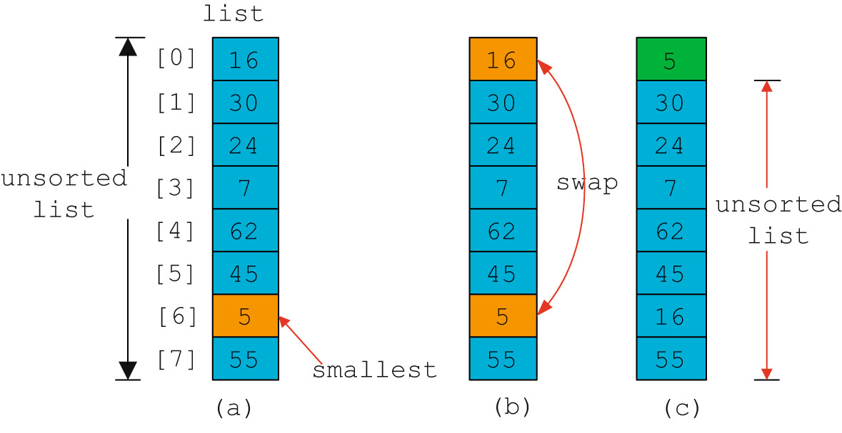
Selection Sort

Slide 34
Recursion vs. Iteration
Recursion is an alternative form of program control. It is essentially repetition without a loop.
Recursion bears substantial overhead. Each time the program calls a method, the system must assign space for all of the method’s local variables and parameters. This can consume considerable memory and requires extra time to manage the additional space.

Slide 35
Advantages of Using Recursion
Recursion is good for solving the problems that are inherently recursive.

Slide 36
Tail Recursion
A recursive method is said to be tail recursive if there are no pending operations to be performed on return from a recursive call.
Non-tail recursive
ComputeFactorial
Tail recursive
ComputeFactorialTailRecursion

Slide 37
Tail Recursion
A recursive method is said to be tail recursive if there are no pending operations to be performed after returning from a recursive call.
Tail recursive
public void run(int x )
{
System.out.println(x);
if (x > 0)
run(x-1);
}
(nothing happens after the recursive call in the method)
Non-tail recursive
public void run(int x )
{
if (x > 0)
run(x-1);
System.out.println(x);
}
(the print action occurs after the recursive call in the method)

Slide 38
Think Recursively
Many of the problems presented in the early chapters can be solved using recursion if you think recursively. For example, the palindrome problem can be solved recursively as follows:
public static boolean isPalindrome(String s)
{
if (s.length() <= 1) // Base case
return true;
else if (s.charAt(0) != s.charAt(s.length() - 1)) // Base case
return false;
else
return isPalindrome(s.substring(1, s.length() - 1));
}
RecursivePalindromeUsingSubstring

Slide 39
Recursive Helper Methods
Sometimes you can find a solution by defining a recursive method to a problem similar to the original problem. This new method is called a recursive helper method. The original method can be solved by invoking the recursive helper method.

Slide 40
Recursive Helper Methods
The preceding recursive isPalindrome method is not efficient, because it creates a new string for every recursive call. To avoid creating new strings, use a helper method:
public static boolean isPalindrome(String s) {
return isPalindrome(s, 0, s.length() - 1);
}
public static boolean isPalindrome(String s, int low, int high) {
if (high <= low) // Base case
return true;
else if (s.charAt(low) != s.charAt(high)) // Base case
return false;
else
return isPalindrome(s, low + 1, high - 1);
}
RecursivePalindrome

Slide 41
Recursive Binary Search
Case 1: If the key is less than the middle element, recursively search the key in the first half of the array.
Case 2: If the key is equal to the middle element, the search ends with a match.
Case 3: If the key is greater than the middle element, recursively search the key in the second half of the array.
RecursiveBinarySearch

Slide 42
Recursive Implementation
/** Use binary search to find the key in the list */
public static int recursiveBinarySearch(int[] list, int key) {
int low = 0;
int high = list.length - 1;
return recursiveBinarySearch(list, key, low, high);
}
/** Use binary search to find the key in the list between
list[low] list[high] */
public static int recursiveBinarySearch(int[] list, int key,
int low, int high) {
if (low > high) // The list has been exhausted without a match
return -low - 1;
int mid = (low + high) / 2;
if (key < list[mid])
return recursiveBinarySearch(list, key, low, mid - 1);
else if (key == list[mid])
return mid;
else
return recursiveBinarySearch(list, key, mid + 1, high);
}

Slide 43
Directory Size
The preceding examples can easily be solved without using recursion. This section presents a problem that is difficult to solve without using recursion. The problem is to find the size of a directory. The size of a directory is the sum of the sizes of all files in the directory. A directory may contain subdirectories. Suppose a directory contains files , , ..., , and subdirectories , , ..., , as shown below.

Slide 44
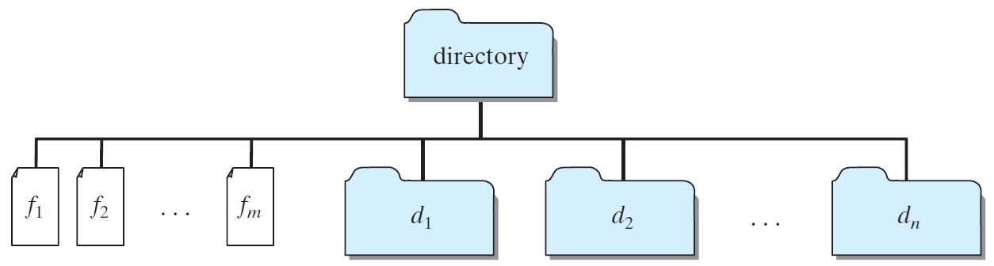
Directory Size
The size of the directory can be defined recursively as follows:
DirectorySize

Slide 45
Tower of Hanoi
There are n disks labeled 1, 2, 3, . . ., n, and three towers labeled A, B, and C.
No disk can be on top of a smaller disk at any time.
All the disks are initially placed on tower A.
Only one disk can be moved at a time, and it must be the top disk on the tower.

Slide 46
Tower of Hanoi Animation
animation
https://liveexample.pearsoncmg.com/dsanimation/TowerOfHanoi.html

Slide 47
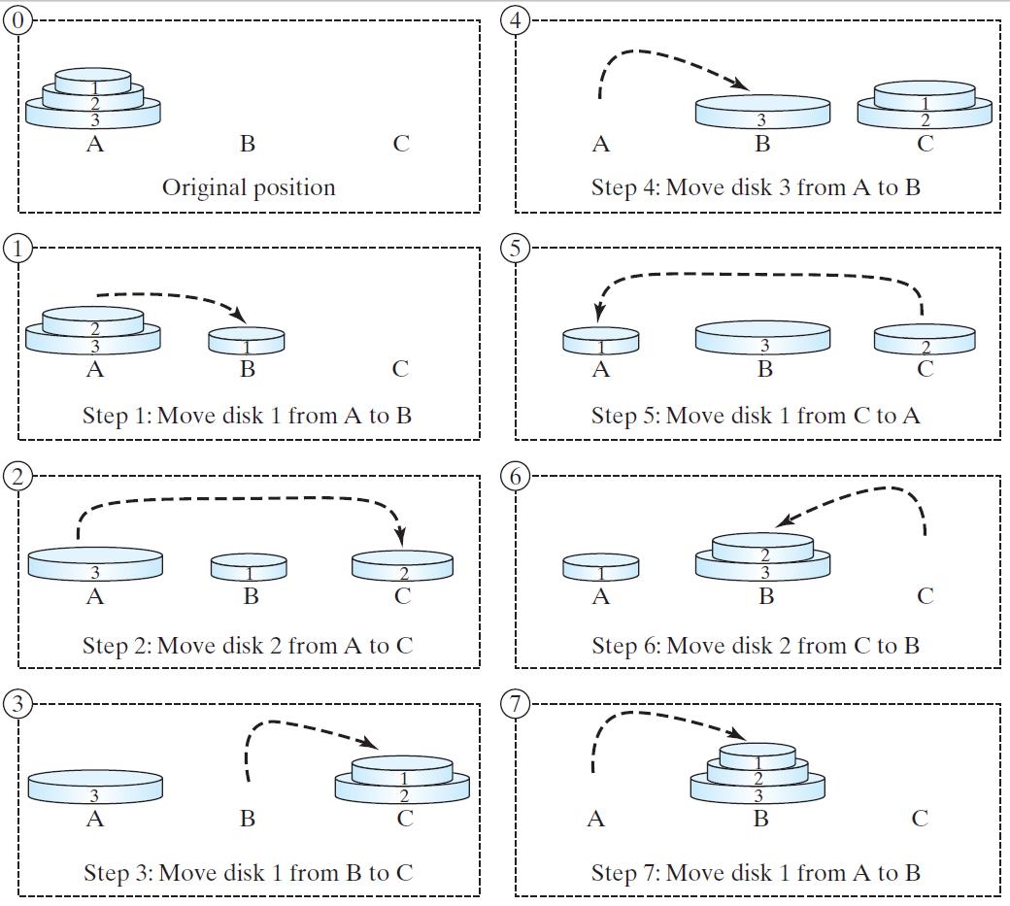
Tower of Hanoi, cont.

Slide 48
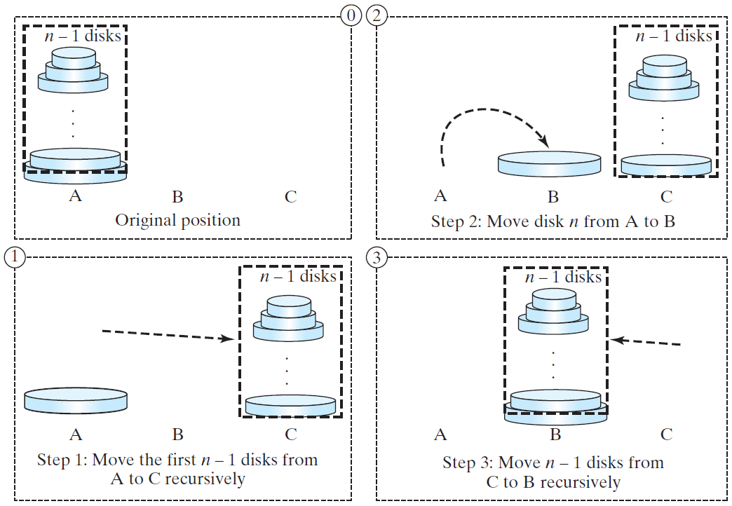
Solution to Tower of Hanoi
The Tower of Hanoi problem can be decomposed into three subproblems.

Slide 49
Solution to Tower of Hanoi
Move the first n - 1 disks from A to C with the assistance of tower B.
Move disk n from A to B.
Move n - 1 disks from C to B with the assistance of tower A.
TowerOfHanoi

Slide 50
Exercise 18.3 GCD
gcd(2, 3) = 1
gcd(2, 10) = 2
gcd(25, 35) = 5
gcd(205, 300) = 5
gcd(m, n)
Approach 1: Brute-force, start from min(n, m) down to 1, to check if a number is common divisor for both m and n, if so, it is the greatest common divisor.
Approach 2: Euclid’s algorithm
Approach 3: Recursive method

Slide 51
Approach 2: Euclid’s algorithm
// Get absolute value of m and n;
t1 = Math.abs(m); t2 = Math.abs(n);
// r is the remainder of t1 divided by t2;
r = t1 % t2;
while (r != 0) {
t1 = t2;
t2 = r;
r = t1 % t2;
}
// When r is 0, t2 is the greatest common
// divisor between t1 and t2
return t2;

Slide 52
Approach 3: Recursive Method
gcd(m, n) = n if m % n = 0;
gcd(m, n) = gcd(n, m % n); otherwise;

